Slide 1
SUB QUERIES

Slide 2
AGENDA
What is Sub Query ?
Single row sub query.
Multiple row sub query.
Correlated Sub query.
Using Sub query in FORM, WHERE Clause and in column.

Slide 3
What is Sub query?
A subquery is used to return data that will be used in the main query as a condition to further restrict the data to be retrieved.
A sub query may return you single row of data or multiple row of data.
Properties:
I. A subquery in the main query that has to be placed on the right-hand side of the comparison operator.
II. A subquery has to be placed parenthesis, in order to get executed first before the main query.
Types of Sub query:
Single row sub query
Multiple row sub query
Correlated Sub query

Slide 4
TYPES OF SUB QUERIES
Single Row Sub Query: Sub query which returns single row output. They mark the usage of single row comparison operators, when used in WHERE conditions.
Example:
select first_name, salary, department_id from employees where salary = (select MAX (salary) from employees);
Here, inner SQL returns only one row i.e. the maximum salary for the employees in a company. It in turn uses this value to compare salary of all the employees and displays only those, whose salary is equal to Maximum salary.

Slide 5
TYPES OF SUB QUERIES
Multiple Row Sub query: Sub query returning multiple row output. They make use of multiple row comparison operators like IN, ANY, ALL. There can be sub queries returning multiple columns also.
Example:
select first_name, last_name, department_id from employees
where department_id in
(select department_id from departments where location_id = 1700);
In the above query, IN matches department ids returned from the sub query, compares it with that in the main query and returns employee's name who satisfy the condition.

Slide 6
TYPES OF SUB QUERIES
Multiple Row Sub query:
Example 2:
select first_name, last_name, department_id from employees
where department_id =
(select department_id from departments where location_id = 1700);
ERROR: more than one row returned by a subquery used as an expression
Here the inner query returns multiple row, so we cannot assign the multiple value using "=" operators.

Slide 7
TYPES OF SUB QUERIES
Correlated Sub query:
A correlated SQL subquery is just a subquery that is executed many times - once for each record (row) returned by the outer (main) query. In other words, the outer query returns a table with multiple rows; the inner query then runs once for each of those rows.
Example:
Correlated sub query

Slide 8
Sub Query in FROM & WHERE clause
In WHERE Clause:
Example:
select first_name, last_name, department_id from employees
where department_id in
(select department_id from departments where location_id = 1700);
In FROM Clause:
Example:
PADC extract Query: PADC query

Slide 9
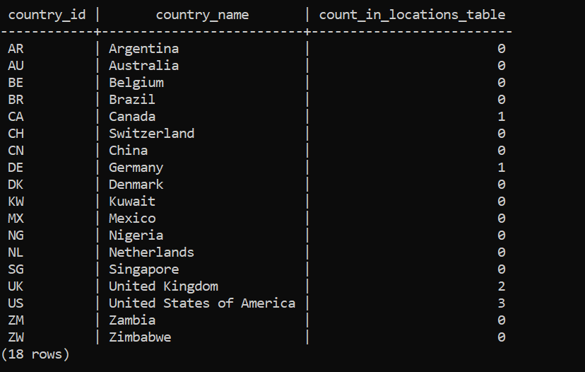
Sub Query in Select statement
In Column:
select country_id, country_name ,
(select count(*) as count_in_Locations_table from locations where locations.country_id = countries.country_id)
from countries;

Slide 10
Thank You

